Slide 1
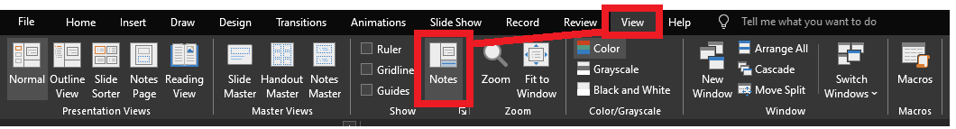
Reviewing after the presentation?
Be sure to enable the Notes for slide-specific content

Slide 2

LIKE, to the max!
(Beyond the % symbol)

Slide 3
stringable1 LIKE stringable2
SELECT [name], [description]
FROM [SomeTable]
WHERE [description] LIKE ...
“Stringable” refers to anything that can be represented as a string, including numerics, datetimes, guids, etc.

Slide 4
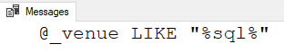
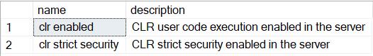
stringable1 LIKE stringable2
DECLARE @_venue varchar(20)
= 'SQL Saturday 20XX'
IF @_venue LIKE '%sql%'
PRINT '@_venue LIKE "%sql%"'
Stringable1 is usually the column (variable-length string)
Stringable2 is usually the shorter string of some pattern to find
Returns boolean
SELECT [name], [description]
FROM master.sys.configurations
WHERE [description] LIKE 'clr%'

Slide 5
% – Wildcard of any length (even zero)
WHERE Column1 LIKE '%' -- returns all non-NULL values
WHERE Column1 LIKE 'A%' -- returns values starting with A
WHERE Column1 LIKE '%A' -- returns values ending with A
WHERE Column1 LIKE 'A%B' -- returns values starting with A
and ending with B
WHERE Column1 LIKE '%B%' -- returns values containing B

Slide 6

%

Slide 7

_
[]
[-]
[^]
%
ESCAPE

Slide 8

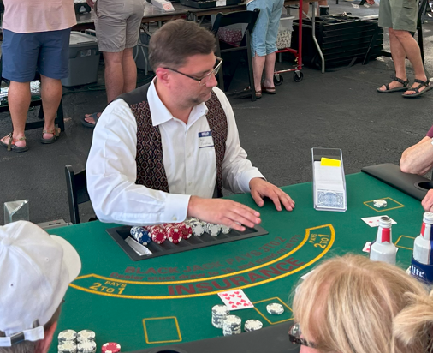
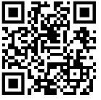


Jeff Foushee
SQL Server Database Admin
Programmer
SQL Saturday speaker
Blackjack dealer
https://www.linkedin.com/in/jeff-foushee/
https://github.com/jbfoushee/MyPresentations/

Slide 9
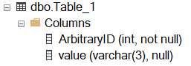
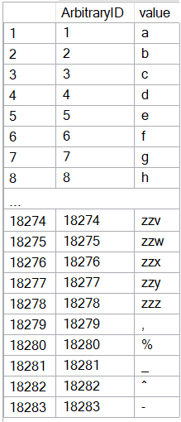
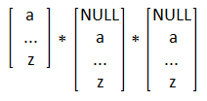
CREATE TABLE dbo.Table_1
( ArbitraryID int IDENTITY(1,1) NOT NULL, [value] varchar(3) )
SET NOCOUNT ON
DECLARE @_text2 varchar(26) = 'abcdefghijklmnopqrstuvwxyz'
DECLARE @_text1 varchar(26) = @_text2
DECLARE @_text0 varchar(26) = @_text1
DECLARE @_p2 tinyint = 0
DECLARE @_p1 tinyint = 0
DECLARE @_p0 tinyint = 0
WHILE 1 = 1
BEGIN
SET @_p2 +=1
IF @_p2 > 26
BEGIN
SET @_p1 += 1
SET @_p2 = 1
END
IF @_p1 > 26
BEGIN
SET @_p0 += 1
SET @_p1 = 1
END
IF @_p0 > 26
BREAK
DECLARE @_text varchar(3) = CONCAT(
SUBSTRING(@_text0, @_p0, 1)
, SUBSTRING(@_text1, @_p1, 1)
, SUBSTRING(@_text2, @_p2, 1) )
INSERT INTO dbo.Table_1 (value) VALUES (@_text)
END
INSERT INTO [dbo].[Table_1] ([value]) VALUES(','), ('%'), ('_'), ('^'), ('-')
INSERT INTO [dbo].[Table_1] ([value]) VALUES(','), ('%'), ('_'), ('^'), ('-')
Notes:
This code will build the sample data used for the demos

Slide 10
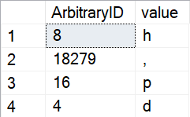
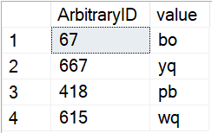
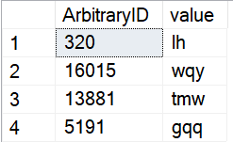
_ – Wildcard of one character (i.e. non-zero length)
SELECT TOP 4 *
FROM dbo.Table_1
WHERE Column1 LIKE '_'
ORDER BY NEWID() -- randomizer
SELECT TOP 4 *
FROM dbo.Table_1
WHERE Column1 LIKE '__'
ORDER BY NEWID() -- randomizer
SELECT TOP 4 *
FROM dbo.Table_1
WHERE Column1 LIKE '__%'
ORDER BY NEWID() -- randomizer
Notes:
The underscore guarantees a length of one character per underscore requested.

Slide 11
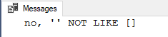
[] – Containment characters
By themselves do nothing
DECLARE @_value varchar(20) = ''
IF @_value LIKE '[]'
PRINT 'yes, '''' LIKE []'
ELSE
PRINT 'no, '''' NOT LIKE []'

Slide 12
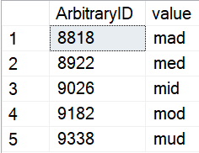
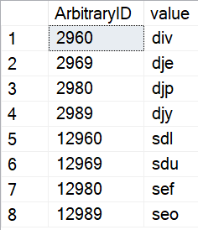
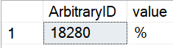
[] – Containment characters
Represent a non-delimited array of allowable characters as one position
% and _ lose their special wildcard ability inside the containment characters
NULL/blank are not acceptable entries for this list
WHERE [value] LIKE 'm[aeiou]d'
WHERE ArbitraryID LIKE '%[2%]9[86][90]'
WHERE [value] LIKE '[%]'

Slide 13
Is LIKE case-sensitive?
No functions, not even UPPER() and LOWER() are case-sensitive
Do you need to follow/enforce something other than the current collation?

Slide 14
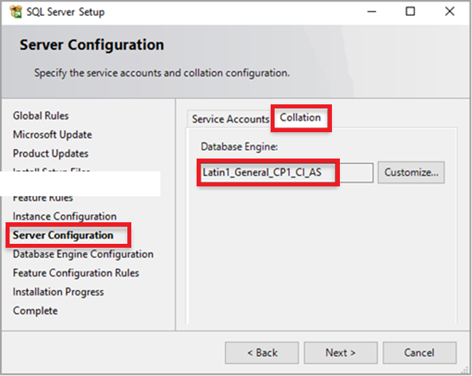
The Collation (Case-Sensitivity) Hierarchy
Instance – What was set when SQL Server was first installed?
SELECT SERVERPROPERTY('collation')
The tempdb database is built off this collation as a clone of master. So any temp tables will have this collation.
Notes:
The instance collation cannot be changed without an effective rebuild of the master database.

Slide 15
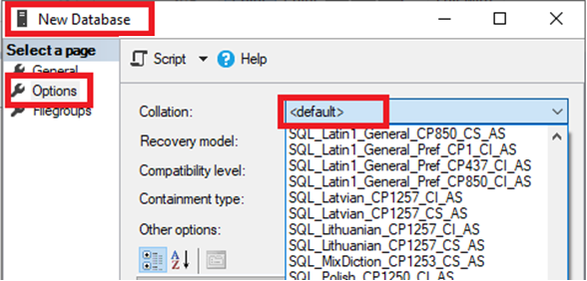
The Collation (Case-Sensitivity) Hierarchy
Instance – What was set when SQL Server was first installed?
Copies the current instance-level collation
Database – Default or explicit?
IF 'A' = 'a'
PRINT 'Case-insensitive database'
ELSE
PRINT 'Case-sensitive database'
SELECT [name], collation_name
FROM [master].[sys].[databases]
WHERE name = DB_NAME()
SELECT DB_NAME(), DATABASEPROPERTYEX(DB_NAME(), 'collation')
Notes:
While the database collation may say “default,” it only says this if it matches the instance collation.
If the instance collation ever changes, the database collation does NOT change with it.

Slide 16
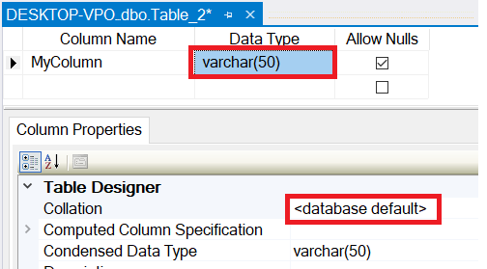
The Collation (Case-Sensitivity) Hierarchy
Instance – What was set when SQL Server was first installed?
Database – Default or explicit?
Table Column – Database default or explicit?
Copies the current database-level collation
SELECT TABLE_SCHEMA, TABLE_NAME, COLUMN_NAME
, DATA_TYPE
, COLLATION_NAME
, CASE Convert(varchar,IsNull(COLLATION_NAME, ''))
WHEN '' THEN ''
WHEN Convert(varchar, DATABASEPROPERTYEX(DB_NAME(), 'collation')) THEN ''
ELSE '*'
END AS Not_As_DB_Collation
FROM INFORMATION_SCHEMA.COLUMNS
ORDER BY TABLE_SCHEMA, TABLE_NAME, COLUMN_NAME
Notes:
The column collation says “database default” if it matches the database collation.
It implies that it is linked to the database collation, but it is not. If the database collation changes, it has no effect on the assigned column collation.

Slide 17
The Collation (Case-Sensitivity) Hierarchy
Instance – What was set when SQL Server was first installed?
FROM Table_1 t1
INNER JOIN Table_2 t2
ON t1.SomeColumn
COLLATE
SQL_Latin1_General_CP1_CI_AS
= t2.SomeColumn
Database – Default or explicit?
FROM Table_1 t1
INNER JOIN Table_2 t2
ON t1.SomeColumn = t2.SomeColumn
Table Column – Database default or explicit?
Cannot resolve the collation conflict between "SQL_Latin1_General_CP1_CI_AS" and "Latin1_General_CI_AS" in the equal to operation.
Query-level – temporarily treat it differently for calculation purposes
Notes:
This error occurs most frequently when the instance collation is not equal to the database collation. Remember, tempdb is built off of master, so your sorts and temporary tables are stored here. Long story short, it is best that instance and database collations match.

Slide 18
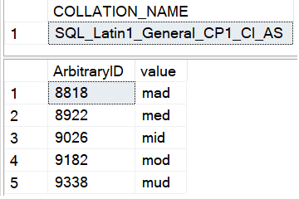
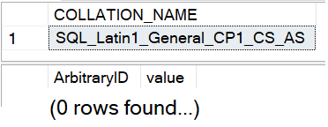
Is LIKE case-sensitive?
No functions, not even UPPER() and LOWER() are case-sensitive
Do you need to follow/enforce something other than the current collation?
-- Request column collation
SELECT isc.COLLATION_NAME
FROM INFORMATION_SCHEMA.COLUMNS isc
WHERE isc.TABLE_NAME = 'Table_1'
AND isc.COLUMN_NAME = 'value’
-- Original query results in CAPS
SELECT t1.ArbitraryID, t1.[value]
FROM Table_1 t1
WHERE t1.[value] LIKE 'M[AEIOU]D'

Slide 19
What if I need to worry about case-sensitivity?
No functions, not even UPPER() and LOWER() are case-sensitive
Do you need to follow/enforce something other than the current collation?
Forcing case-sensitivity on an case-insensitive column:
WHERE [CI_value] COLLATE Latin1_General_CS_AS LIKE 'm[aeiou]d'
Forcing case-insensitivity on an case-sensitive column:
WHERE [CS_value] COLLATE Latin1_General_CI_AS LIKE 'm[aeiou]d'
WHERE [CS_value] LIKE '[mM][aAeEiIoOuU][dD]'
WHERE LOWER([CS_value]) LIKE 'm[aeiou]d'
Notes:
If you plan to use these types of queries often, you might consider building a persisted computed column to speed up finding these results. You can index a computed column.

Slide 20
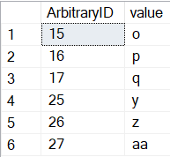
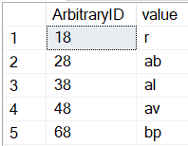
[-] – Range character
Provides a shortcut to consolidate characters on its immediate left and right
Characters must be contiguous. Lower value must be on the left.
WHERE [ArbitraryID] LIKE '[1-2][5-7]'
WHERE [ArbitraryID] LIKE '[1-46]8'
1 5
2 6
7
1
2
3 8
4
6

Slide 21
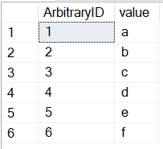
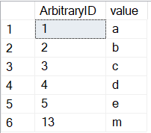
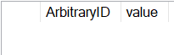
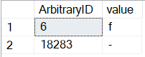
[-] – Range character
Provides a shortcut to consolidate characters on its immediate left and right
Characters must be contiguous. Lower value must be on the left.
WHERE [value] LIKE '[a-f]'
WHERE [value] LIKE '[a-em]'
WHERE [value] LIKE '[f-a]'
WHERE [value] LIKE '[-f]'

Slide 22
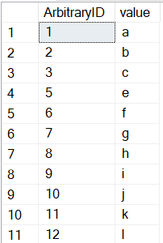
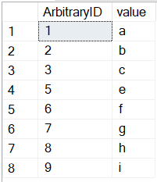
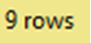
[^] – Negation character
Provides a “NOT” to all characters on its right
Must be the FIRST character within the containment characters to take effect
WHERE [ArbitraryID] LIKE '[^4]'
WHERE [ArbitraryID] NOT LIKE '[4]'

Slide 23
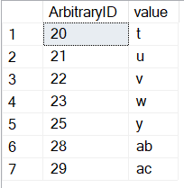
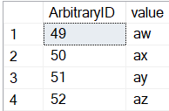
[^] – Negation character
Provides a “NOT” to all characters on its right
Must be the FIRST character within the containment characters to take effect
WHERE [ArbitraryID] LIKE '2[^467]'
WHERE [value] LIKE 'a[^a-v]'

Slide 24
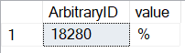
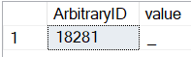
ESCAPE stringable
WHERE [value] LIKE '%\%%' ESCAPE '\'
WHERE [value] LIKE '%!_%' ESCAPE '!'
Notes:
If you really want to search for the %, _ , or [ characters, you can use the ESCAPE keyword to remove the special powers of the character

Slide 25
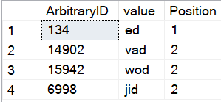
PATINDEX(like_pattern, stringable)
Returns the starting position of the first occurrence of a pattern in a specified expression, or zero if the pattern is not found, on all valid text and character data types.
(our familiar patterns)
SELECT TOP 4 ArbitraryID
, [value]
, PATINDEX('%[aeiou]d', [value]) AS Position
FROM dbo.Table_1
WHERE [value] LIKE '%[aeiou]d'
ORDER BY NEWID() -- randomizer

Slide 26
On the horizon, true RegEx…
https://devblogs.microsoft.com/azure-sql/introducing-regular-expression-regex-support-in-azure-sql-db/
Function | Description
REGEXP_LIKE() | This function returns TRUE if a string matches a regular expression pattern, or FALSE otherwise
REGEXP_COUNT() | This function returns the number of times a regular expression pattern matches in a string
REGEXP_INSTR() | This function returns the starting or ending position, based on the specified option, of the given occurrence of a regular expression pattern in a string.
REGEXP_REPLACE() | This function returns a substring that matches a regular expression pattern from a string.
REGEXP_SUBSTR() | This function returns a modified string replaced by a ‘replacement string’, where occurrence of the regular expression pattern found.

Slide 27
Jeff Foushee
SQL Server Database Admin
Programmer
SQL Saturday speaker
Blackjack dealer
https://www.linkedin.com/in/jeff-foushee/
https://github.com/jbfoushee/MyPresentations/

Slide 28

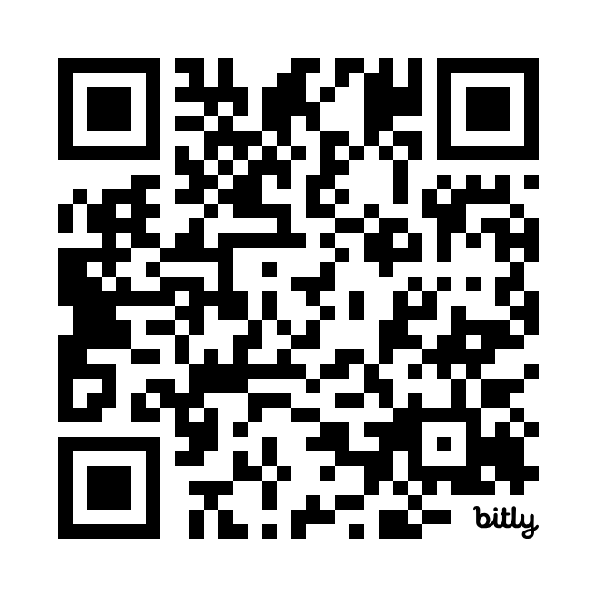

LIKE, to the max! (Beyond the % symbol)
https://github.com/jbfoushee/MyPresentations/
Scan the QR code to submit session evaluations.

